Slide 2
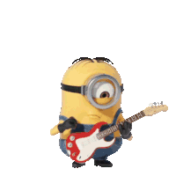
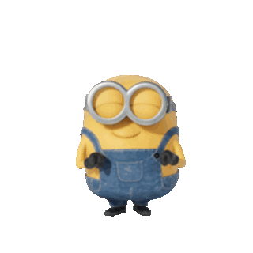
Are you a doctor?
No, I’m not.
I’m a singer.

Slide 3
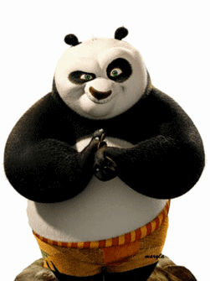
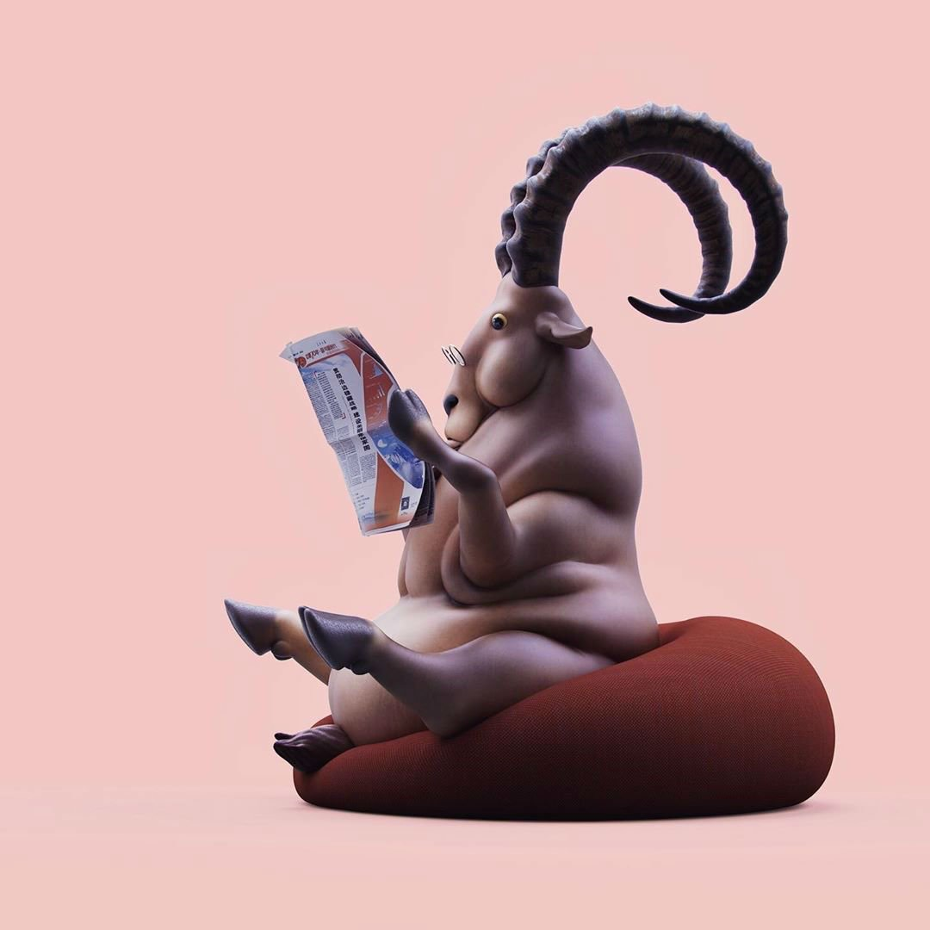
Did you finish your homework?
Maybe…yes!

Slide 4
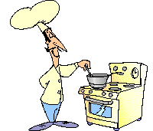
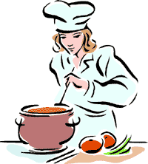
c
o
o
k

Slide 5
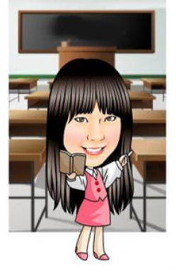
t
e
a
c
h
e
r

Slide 6
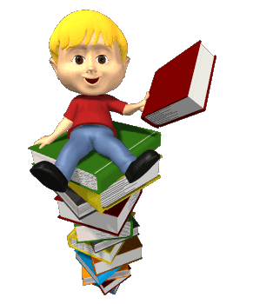
s
t
u
d
e
n
t

Slide 7
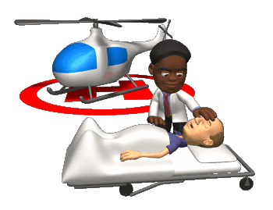
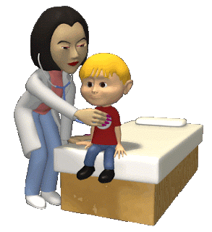
d
o
c
t
o
r

Slide 8
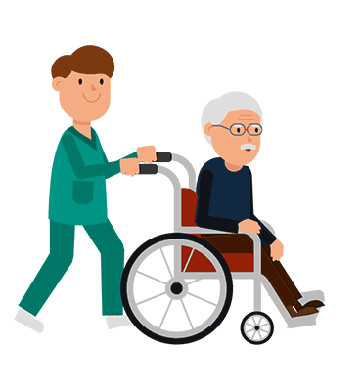
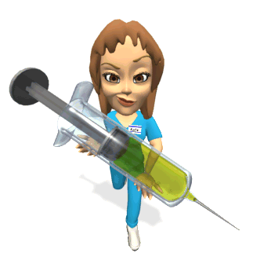
n
u
r
s
e

Slide 9
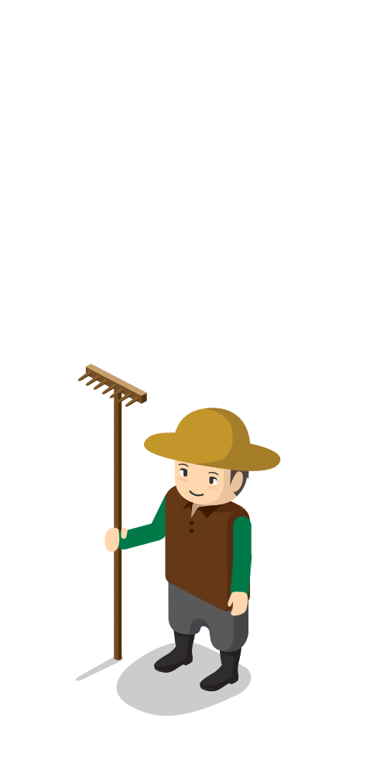
f
a
r
m
e
r

Slide 10
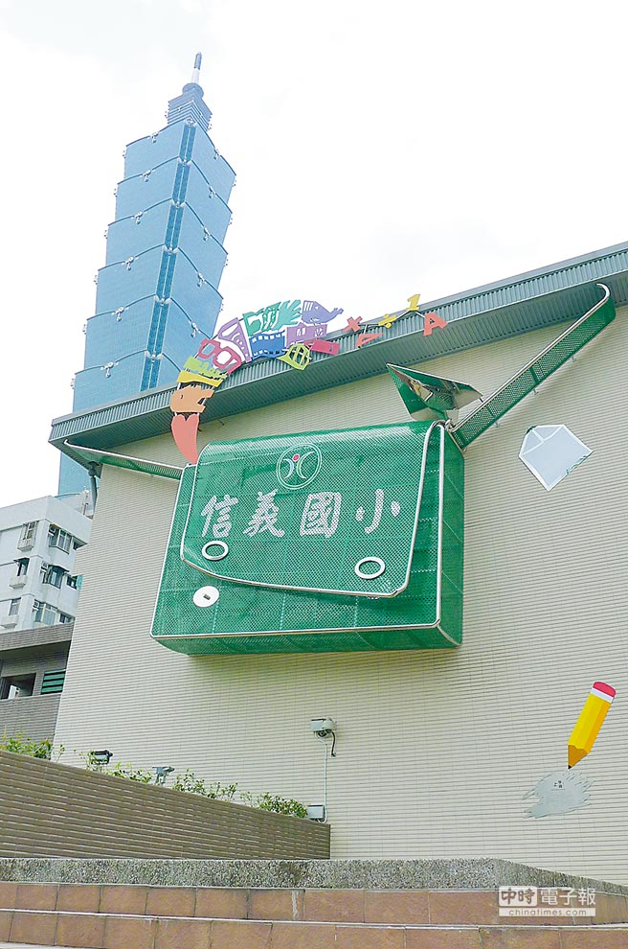
Are you a student?
Yes, I am.

Slide 11
Are you a cook?
No, I’m not.

Slide 12
Is he a teacher?
Yes, he is.

Slide 13
Is she a doctor?
No, she isn’t.

Slide 14
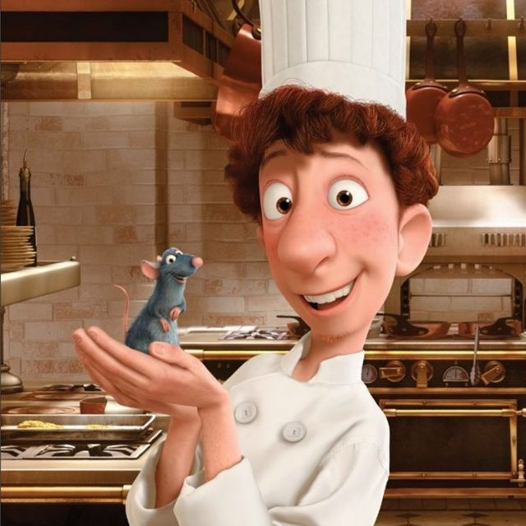
Is it a cook?
Yes, it is.

Slide 15
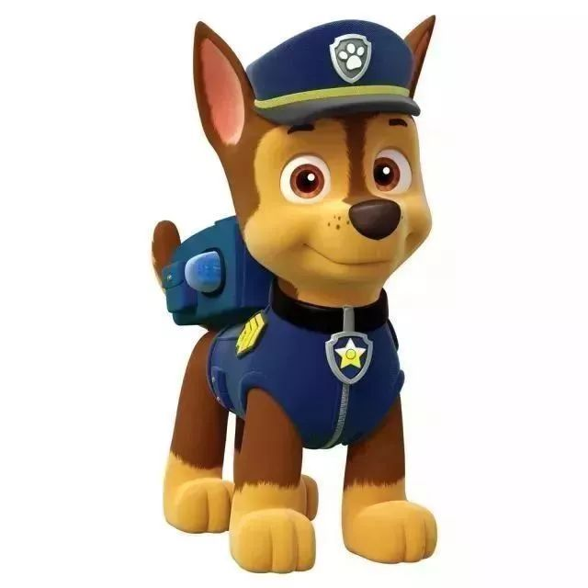
Is it a student?
No, it isn’t.
It’s a patrol.

Slide 16
Is he a doctor?
No, he isn’t.
He’s a businessman/
superhero .

Slide 17
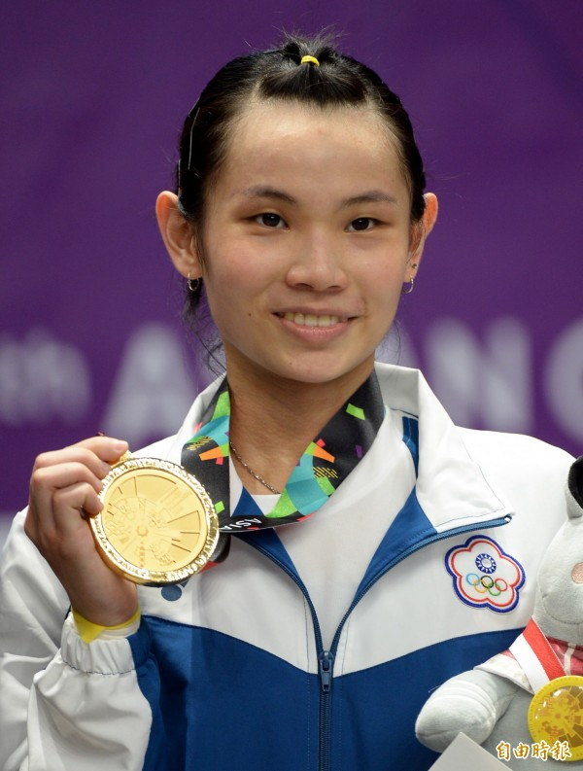
Is she a farmer?
No, she isn’t.
She’s a badminton player.
戴資穎/ Tai Tzu Ying

Slide 18
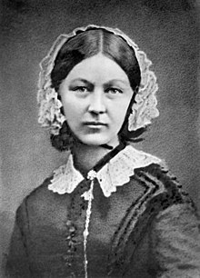
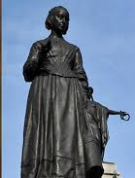
Is she a nurse?
Yes, she is.
佛蘿倫絲·南丁格爾/ Florence Nightingale

Slide 19
Is he a doctor?
No, he isn’t.
He’s a teacher.
孔子/ Confucius

Slide 20
Yes, I am.
Yes, he is.
Yes, she is.
No, I’m not.
No, he isn’t.
(he’s not)
No, she isn’t.
(she’s not)
Yes簡答不可以縮寫

Slide 22
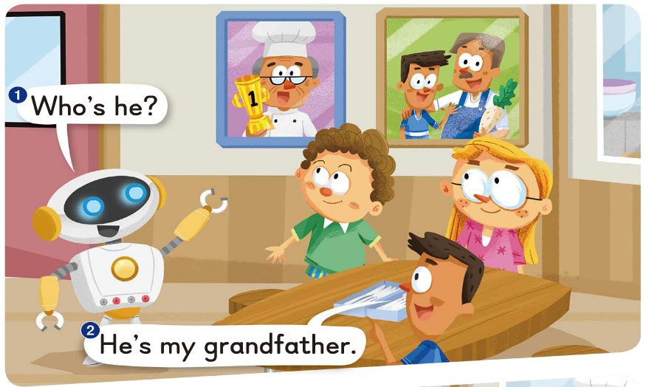

Slide 23
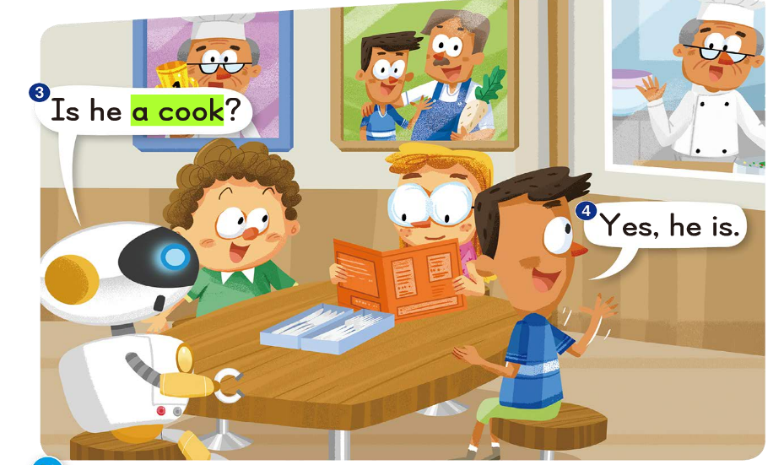

Slide 24
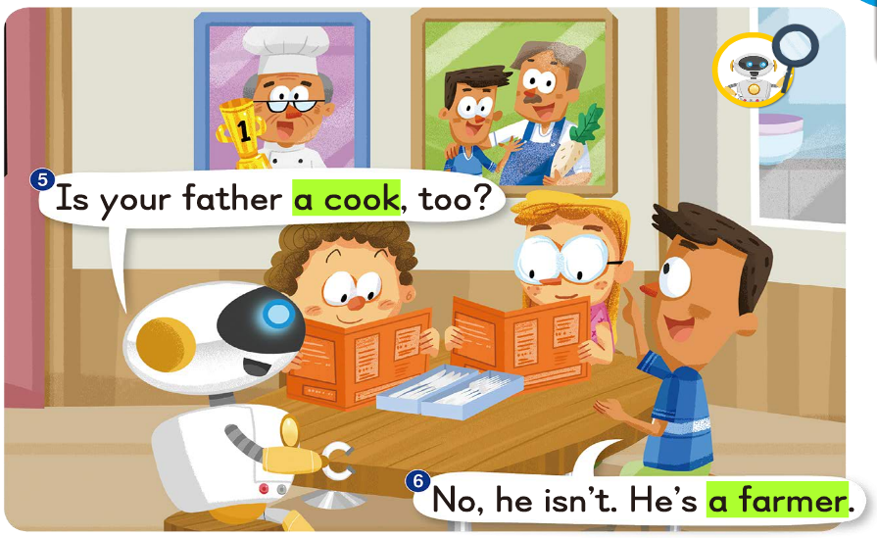

Slide 25
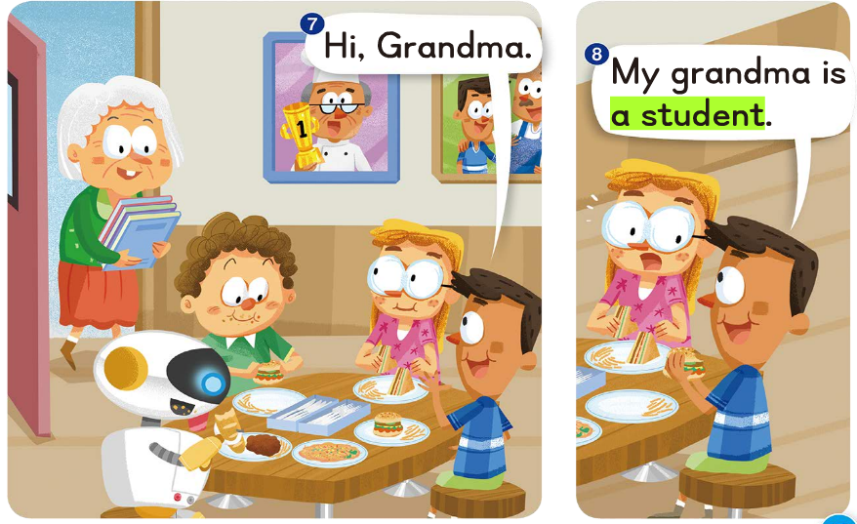

Slide 26
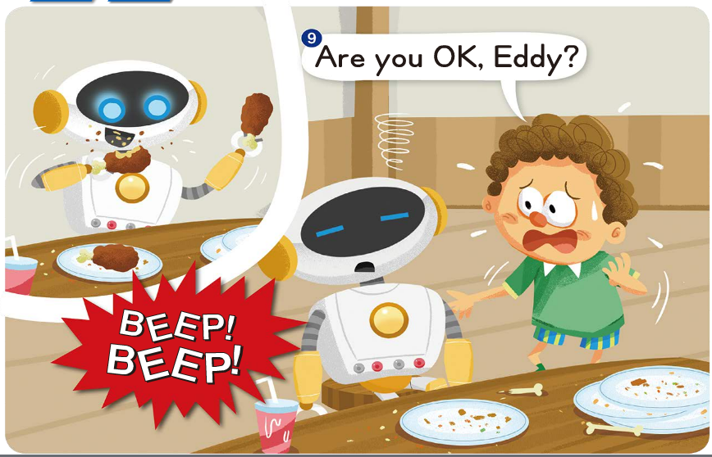

Slide 27
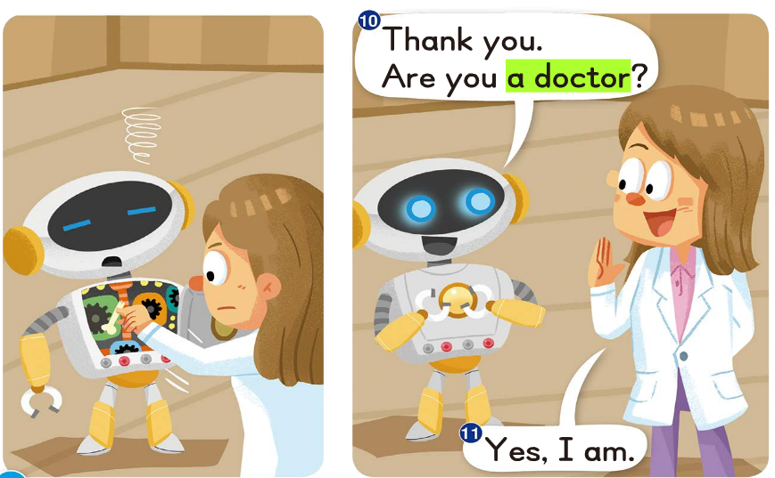

Slide 29
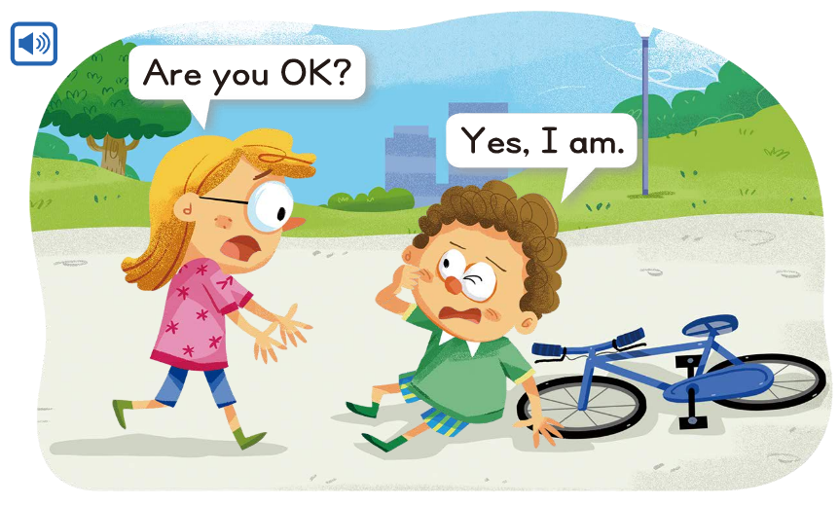

Slide 30
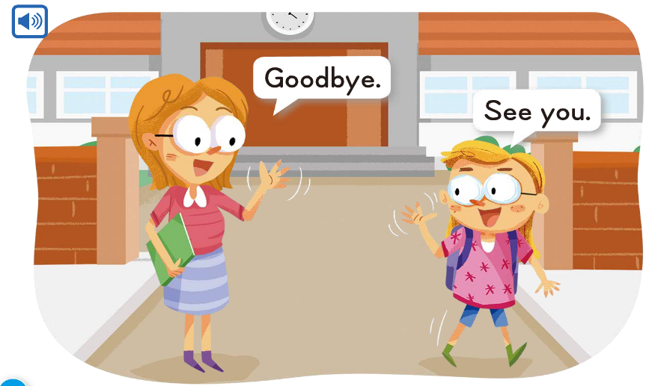

Slide 31
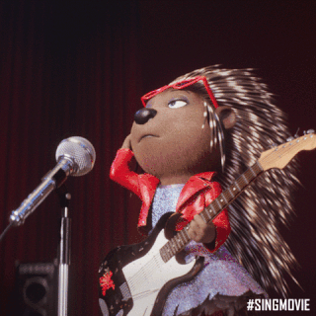

Slide 33
-ug
-ut

Slide 34
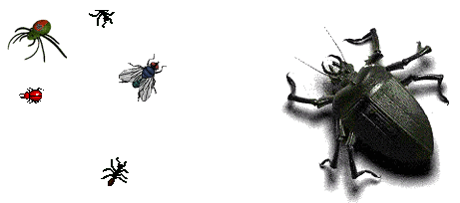
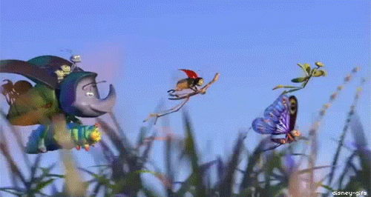
b
ug

Slide 35
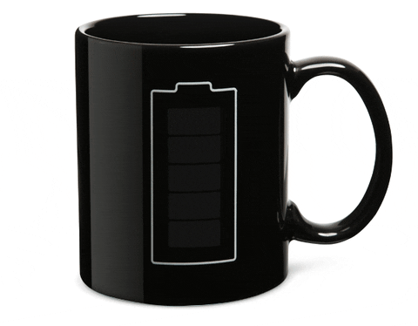
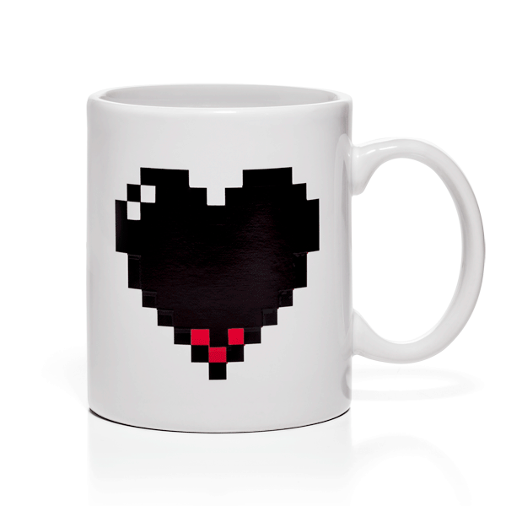
m
ug

Slide 36
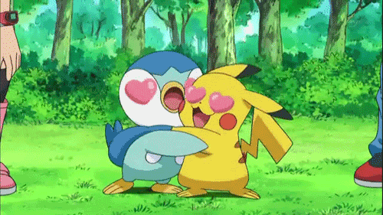
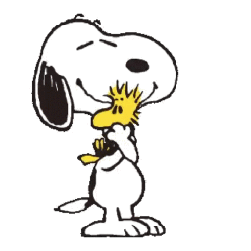
h
ug

Slide 37
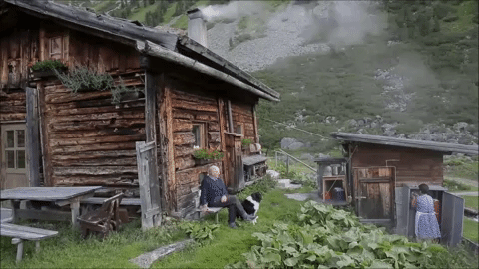
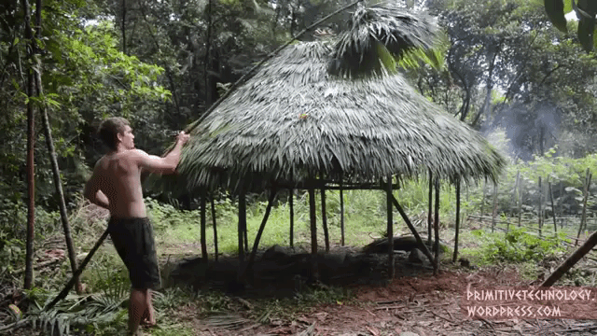
h
ut

Slide 38
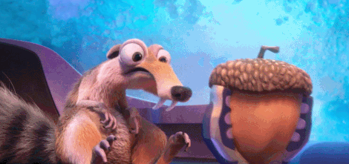
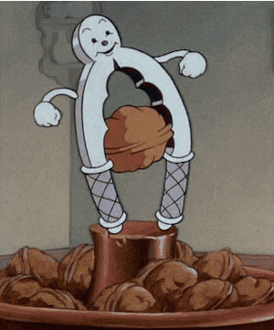
n
ut

Slide 39
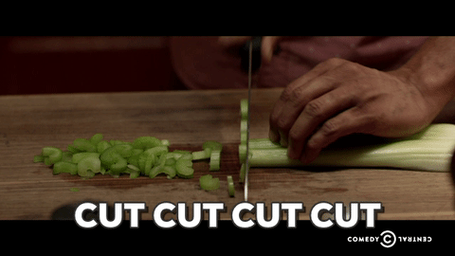
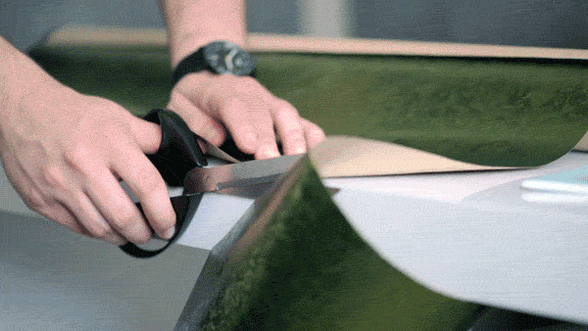
c
ut

Slide 40
ug
ut
bug
mug
hug
hut
nut
cut

Slide 42
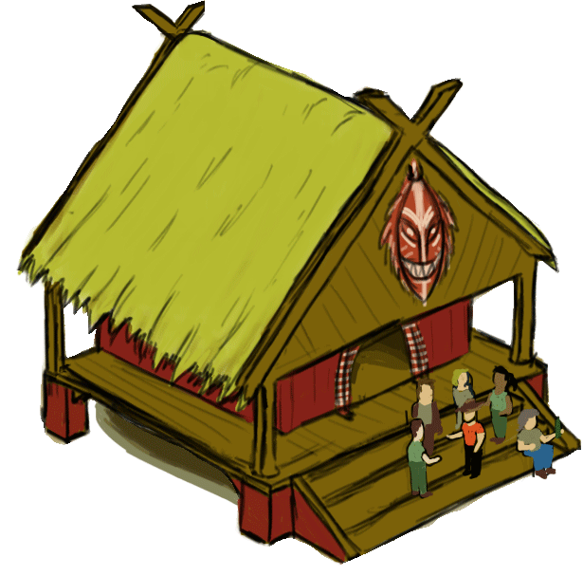
The mug is in the hut.

Slide 43
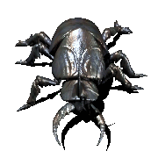
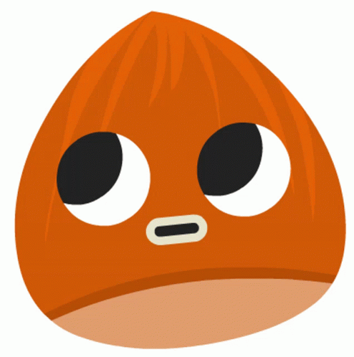
The bug has a nut.

Slide 44
The bug has a nut
by the hut.

Slide 45
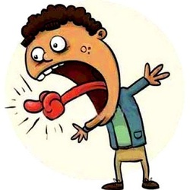
The mug is in the hut.
The bug has a nut.
The bug has a nut
by the hut.

Slide 46
